Slide 1
SUPERNOVA,
ALGORITHMS BEYOND US
TAOBAO FULLSCREEN BANNER ADS
SHOWING UP ON OTHER APPS
By Liuliu Zhu

Slide 2
CONTENTS
01 - Podcast
02 - Concept
03 - Structure

Slide 3
01 - PODCAST

Slide 4

02 - CONCEPT
Taobao fullscreen banner ad showing up on other apps

Slide 5
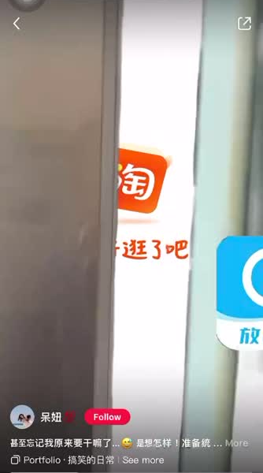
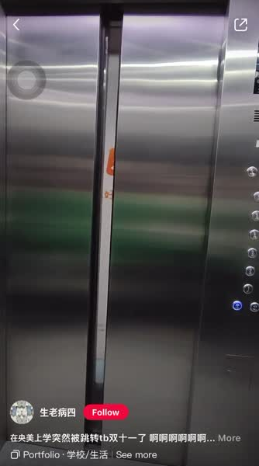
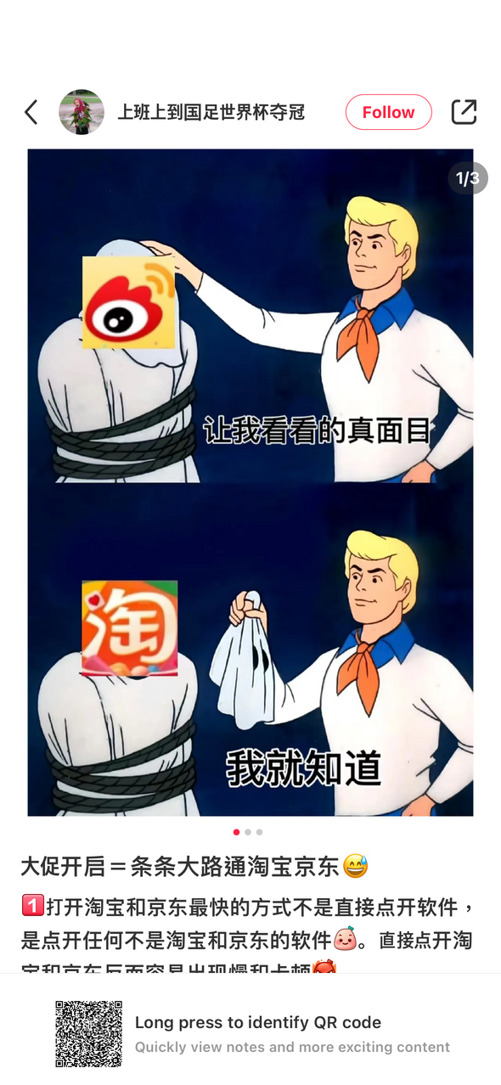

Slide 6
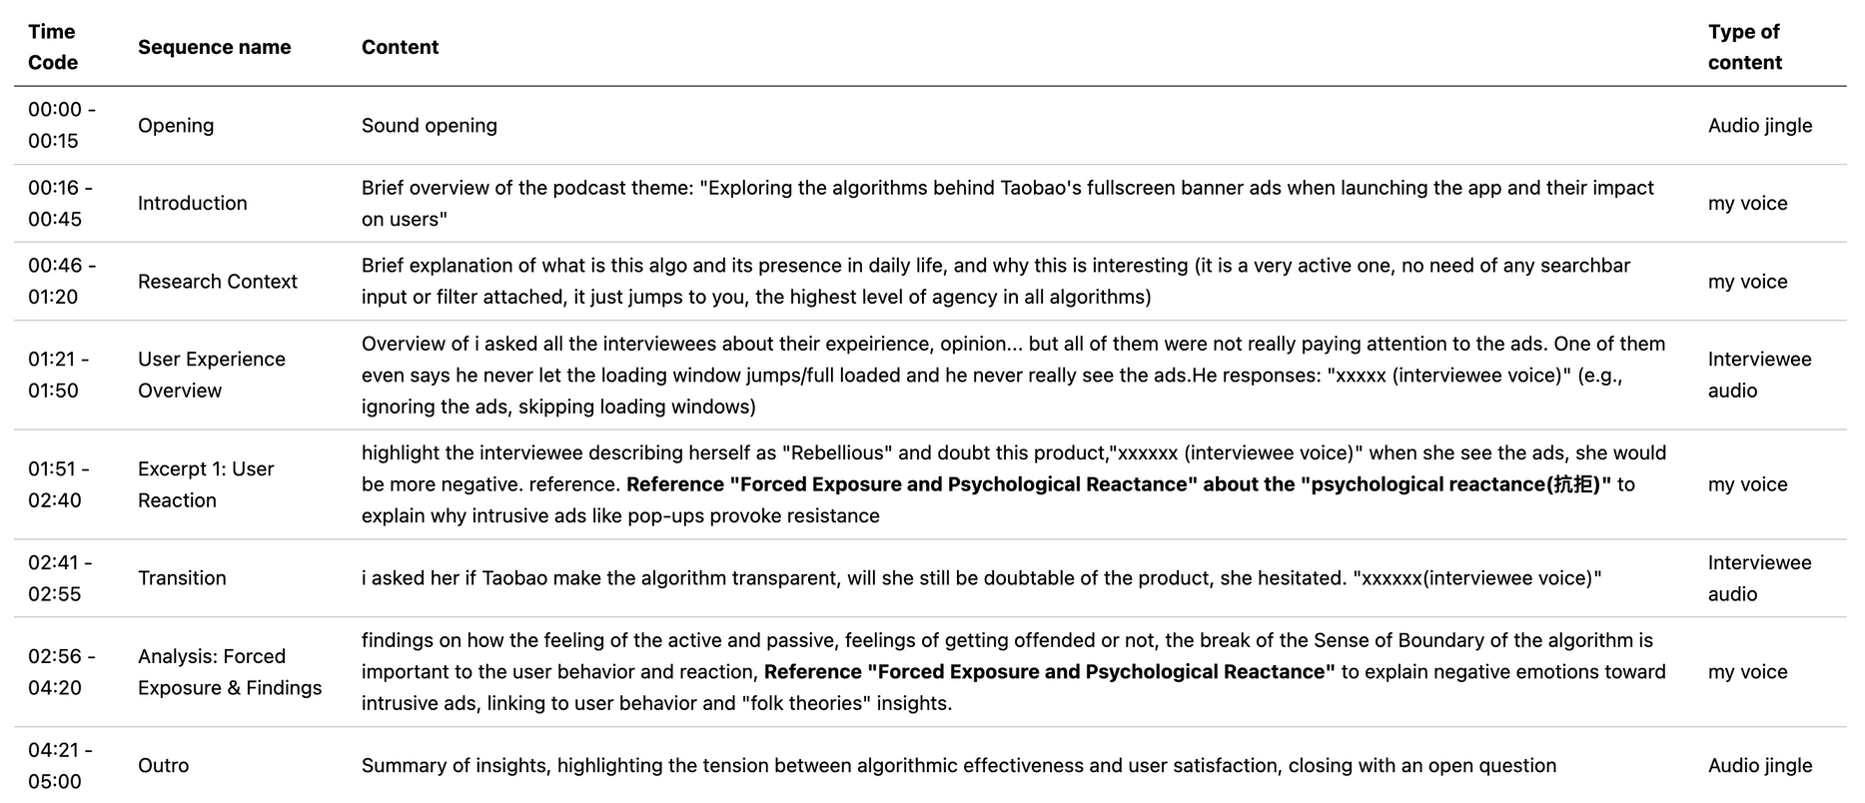
03 - STRUCTURE
ADS <——> ALGORITHM
form/gesture/appearance <——> content
Active <——> Passive

Slide 7
THANKS

